Slide 1
PyPregel
Chufeng Gao, Hongxin Chu, Zichen Wang

Slide 2
PyPregel
Motivation
Architecture
Improvement
Experiments

Slide 3
Motivation
Parallelize graph algorithms is painful.
Lots of redundant, duplicate work needs to be done.
E.g. log, metrics, fault tolerant, coordination between nodes
No existing parallel graph computation system in python.

Slide 4
PyPregel Architecture
Parallel System for large scale graph processing
Compute graph as a sequence of Supersteps

Slide 5
PyPregel
PyPregel is a python implementation of Pregel¹ system.
Designed for programs that are expressed as a sequence of iterations.
At a iteration, each vertex can:
Receive messages sent in the previous iteration
Send messages to other vertices
Modify its own state (vertex value, outgoing edges)
We call a iteration as Superstep in PyPregel
Our GitHub link: https://github.com/Zichen-Wang/pypregel

Slide 6
PyPregel: Vertex
PyPregel distributes vertices across Workers. Workers compute in parallel.
A vertex consists of following states:
current value
outgoing edges
a queue containing received messages from last Superstep
a queue containing incoming messages for current Superstep
a flag specifying whether the vertex is active

Slide 7
PyPregel: Supersteps
PyPregel performs a sequence of Supersteps until termination.
At a Superstep, Workers apply user defined Compute() to every vertex.
A Compute() can:
Process messages received in last Superstep
Compute/Modify its own state (vertex value, outgoing edges)
Send messages to other vertices
Deactivate vertex
Then a set of Aggregators provided by user is applied on local vertices.

Slide 8
PyPregel: Aggregator
After Compute() in a Superstep S, PyPregel uses user defined Aggregators to aggregate values on local vertices and reduce partial aggregated results from Workers to Master.
Aggregate results from Superstep S in Master is broadcasted to all Workers in Superstep S + 1.
The Aggregator:
Specifies how to aggregate values of local vertices
Specifies how multiple partially aggregated values are reduced to one
When terminate, final aggregate result is stored in Master.

Slide 9
PyPregel: Termination
PyPregel terminates when all vertices are inactive.
Deactivate:
A vertex can only be deactivated by user defined Compute()
Activate:
All vertices start with active state
when a vertex receive a message from last Superstep

Slide 10
Challenges
No open source code for reference
Only high level idea is presented in Pregel paper.
Implementation details need to be filled in.
Message send and receive needs to happen simultaneously.
Performance and reliability trade off.

Slide 11
Master
Messages
Start Superstep S
Start Superstep S
Superstep S starts
Worker 1
Worker 2
Vertex messages
Worker 1
Barrier
Worker 2
Superstep S ends
Barrier
Barrier
Master
Start Superstep S + 1
Start Superstep S + 1
Superstep S + 1 starts
Worker 1
Worker 2

Slide 12
Start Superstep S
Message flow
Main
Sender
Receiver
Threads
Receive Buffer
Message for Worker 2
Send Buffer
Worker 2
2
1
2
1
Compute()
3
2
1
Worker 2
Send to worker 2
1
1
Superstep S
Worker 1’s view
2
2
3
3
1
Worker 3
3
3
3
Send to worker 3
1
1
1
3
3
done
Aggregate()
Barrier()

Slide 13
Improvement
Combiner: Vertex messages sent can be combined before sending out/after receiving.
Message Accumulation: message are accumulated before sending out. Only send when reach a threshold or timeout.

Slide 14
Improvement: Combiner
Messages in the shared queue may be combined to reduce communication overhead and space needed.
This can be done by providing a Combine() interface for user to implement.
Each destination vertex now has a single message stored.
Call Combine() on new message with original message.
Flush when a certain amount of messages is accumulated or timeout.

Slide 15
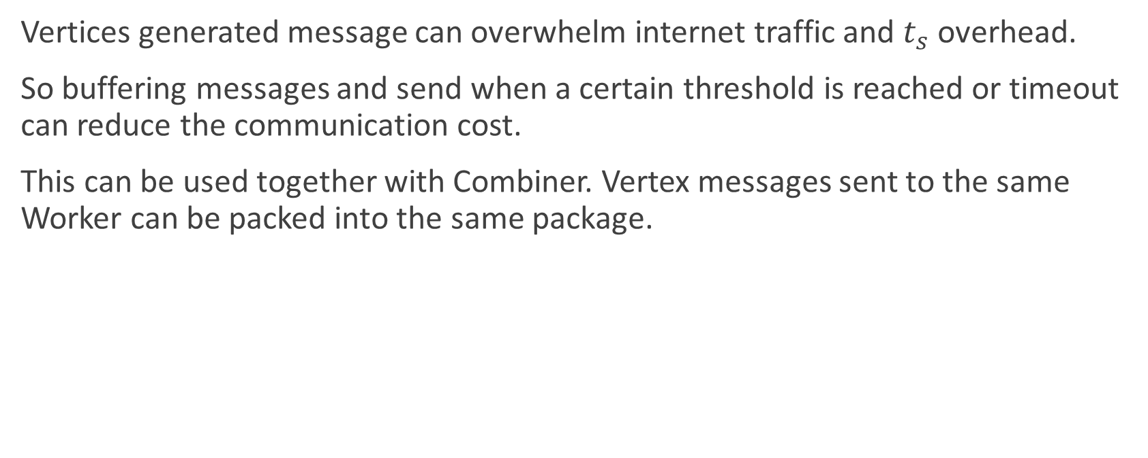
Improvement: Message Accumulation
Vertices generated message can overwhelm internet traffic and $t_{s}$ overhead.
So buffering messages and send when a certain threshold is reached or timeout can reduce the communication cost.
This can be used together with Combiner. Vertex messages sent to the same Worker can be packed into the same package.

Slide 16
Message flow
Threads
Main
Sender
Receiver
Send Buffer
Receive Buffer
2
Message for Worker 2
Worker 2
2
Vertex 2
1
1
3
Vertex 2
2
2
Vertex 2
Timeout
2
Send
1
Worker 2
Superstep S
Worker 1’s view
3
Vertex 3
1
1
Combine()
3
Vertex 2
3
Vertex 3
1
1
Worker 3
3
3
Combine()
1
1
Combine()
Vertex 3
Vertex 2
1
3
Timeout
3
Send
3
Vertex 3
done

Slide 17
Experiments
PageRank
Single Source Shortest Path

Slide 18
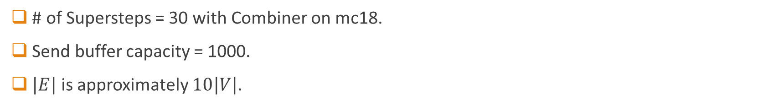
PageRank
# of Supersteps = 30 with Combiner on mc18.
Send buffer capacity = 1000.
$|E|$ is approximately $10|V|$.

Slide 19
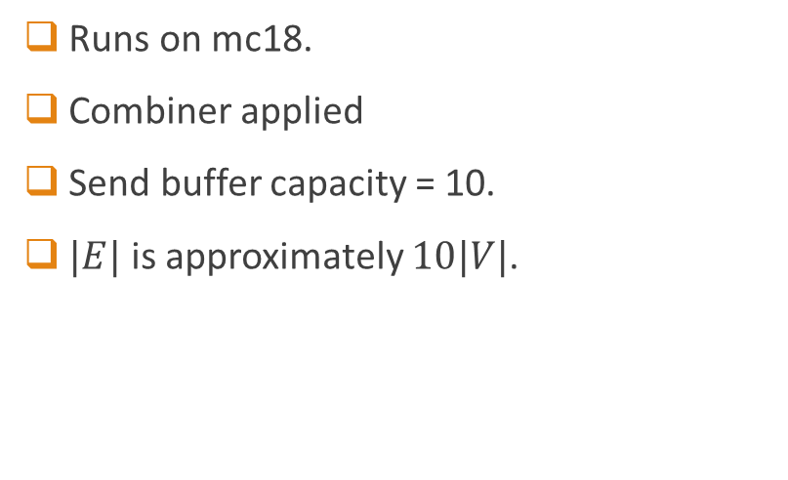
Single Source Shortest Path
Runs on mc18.
Combiner applied
Send buffer capacity = 10.
$|E|$ is approximately $10|V|$.

Slide 20
Reference
1. Malewicz, Grzegorz, et al. "Pregel: a system for large-scale graph processing." Proceedings of the 2010 ACM SIGMOD International Conference on Management of data. 2010.

